Slide 1
Calmare Therapy for Chronic Pain Management
April Schmidt, RN, BSN
Duke University Nurse Anesthesia Program

Slide 2
Course Objectives
Participants will be able to define what Calmare therapy is and describe the mechanism by which it works.
Participants will be able to state 3 pain conditions that may be treated with Calmare.
Participants will be able to list 4 advantages of using Calmare therapy over traditional chronic pain management treatments.
Participants will be able to list 3 contraindications to Calmare therapy.

Slide 3
The Problem: Chronic Pain
Widespread issue
Millions of Americans live with chronic pain everyday
Many are unable to perform ADLs or work
Many disability claims are due to chronic pain
Sleep and mood disturbances

Slide 4
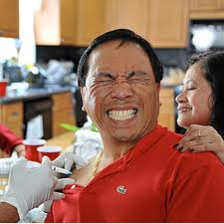
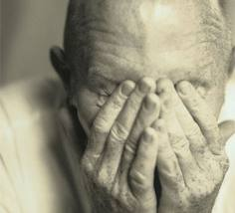
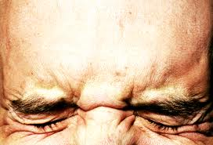
What does pain look like?

Slide 5
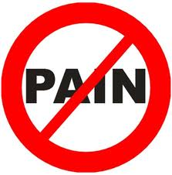
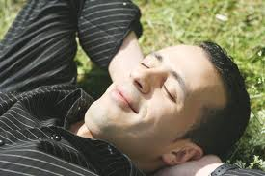
What does pain free look like?

Slide 6
Chronic Pain Review
C fibers: unmyelinated, smaller (diameter 0.4-1.2 µm)
Transmit second pain or slow pain
Burning, aching, throbbing pain
Major neurotransmitter is substance P which binds to neurokinin-1 receptors postsynaptic
Duration exceeds duration of stimulus

Slide 7
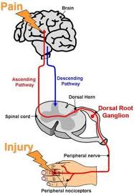
Review Chronic Pain Pathway
Primary afferents-DRG
Dorsal Horn of SC
Ascend/Descend 1-3 segments in Tract of Lissauer
Primary afferents synapse with 2nd order neurons
Terminate in Rexed’s Laminae II and III then V via interneurons

Slide 8
Chronic Pain Pathway con’t
Decasate and ascend in contralateral lateral spinothalamic tract to reach the thalamus
Synapse with 3rd order neurons to send message to cerebral cortex

Slide 9
What is Calmare?
Calmare-Italian for “to soothe or ease”
Non-invasive nerve “scrambler” for treatment of drug-resistant chronic neuropathic and cancer pain.
FDA approved in 2009
Used in Europe for several years prior

Slide 10
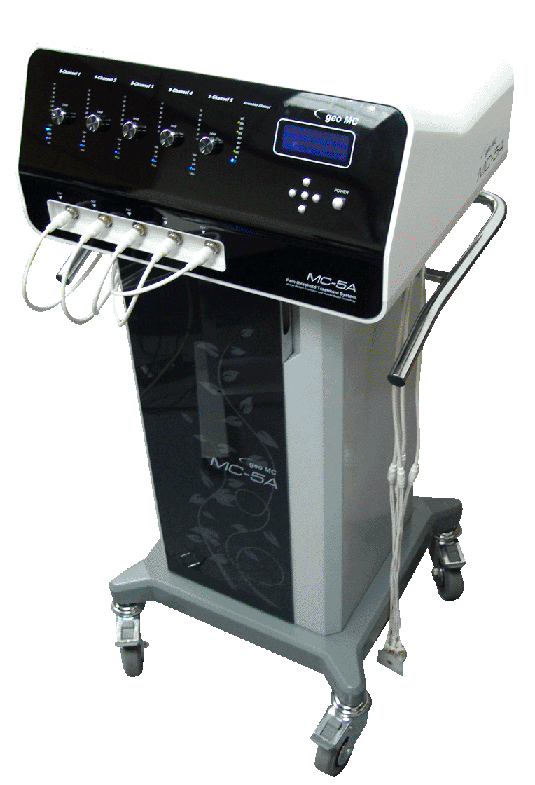
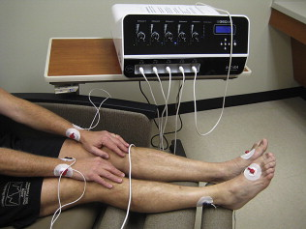
Calmare

Slide 11
How does Calmare work?
Device creates and sends a “no pain” signal which becomes the dominant signal received by the brain changing the patient’s perception of pain.
Biophysical rather than biochemical approach
Transdermal modulation of pain using 5 mA
Utilizes 5 different “channels” each with independent output intensity

Slide 12
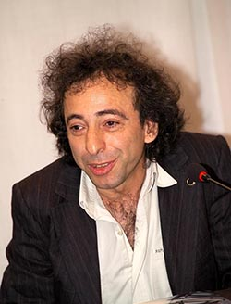
Inventor: Giuseppe Marineo
Researcher and bioengineer
Began research in 1983
Also developed Entropy Variation System –treats chronic degenerative disease by regenerating tissue (cirrhosis)

Slide 13
Treatment regimen
10-12 consecutive treatments; one 30-45 min. treatment per day over a period of two weeks
During therapy, some patients report “0” pain.
Patients may experience significant pain reduction for an extended period of time (time length dependent upon underlying cause)
Booster cycles can be given when needed

Slide 14
Conditions Treatable with Calmare
Chemotherapy-induced peripheral neuropathy
Intractable Cancer pain
Failed back surgery syndrome
Sciatic and lumbar pain
Post-herpatic neuralgia
Post-surgical pain
Brachial plexus injury pain
Low Back/neck pain
Chronic Neuropathic pain
Phantom limb pain
Reflex sympathetic dystrophy

Slide 15
Advantages of Calmare
Non-invasive
Painless procedure
Immediate pain relief
Ongoing pain control
No adverse side effects of opioids

Slide 16
Cost
10 sessions cost $1,500-2,000
Not covered by many insurances-why?
CPT coding as of 1/2012
Since then more insurances are starting to cover Calmare

Slide 17
Contraindications to Calmare
Pacemaker or AICD
Vena cava or aneurysm clips
Coronary/vascular stents
Pregnancy
Hx of epilepsy
Hx of brain damage
Brain metastasis
Anticonvulsant meds
Hx of celiac plexus block
Cardiac ischemia
Severe arrhythmias
Implanted nerve stimulators
Latex allergies

Slide 18
Risks
Closure of airway: Stimulation over the neck (laryngeal and pharyngeal) due to muscle contractions may be strong enough to close the airway
Cardiac arrhythmias: Machine capable of delivering 25 micro coulombs so electrodes placed in a trans-thoracic position may cause cardiac arrhythmia

Slide 19
Research: Ricci, Pirotti, Scarpi, Burgio, Maltoni, Sansoni, & Amadori, 2011
Prospective, exploratory, non-controlled study
73 adult pts (40 with cancer pain, 33 non-cancer pain) all with pain > 5/10, Median age 66, males and females evenly divided
Purpose: To assess efficacy and tolerability of the device.
Numerical rating scale: 1-4=mild, 5-6=moderate, 7-10=severe

Slide 20
Results: Ricci et al, 2011

Slide 21
Results: Ricci et al., 2011
Performance slightly greater in the non-cancer group (perhaps bc cancer group started with lower baseline pain)
At 1 mth after tx start, 81% of overall participants had responded (8% of them only partially)and 19% had not.
No side effects reported
97% of pts said they would repeat this tx

Slide 22
Testimonial
Camp Lejeune- pt with GSW to RUE-chronic neuropathic pain-unable to use RUE at all.
Treatments tried: surgery, opioids, non-opioid analgesics, brachial plexus blocks
After Calmare therapy, pt experienced significant reduction in pain
Able to return to work and hold his newborn baby!

Slide 23
Where is Calmare available?
Arizona-2
California-3*
Connecticut-2
Florida-3*
Illinois-1
Maryland-2*
Montana-1
New Jersey-1
New York-3
North Carolina-1 *
Oklahoma-1
Rhode Island-1
Texas-1
Utah-3
Virginia-3*
Washington-1*
Wisconsin-1
Wyoming-1

Slide 24
Further Research Needed
Need RCTs
Need larger studies
Need studies on children
Need long-term studies:
-How long does the pain relief last?
-Number of treatments needed to maintain pain relief?
-Any side effects long-term?

Slide 25
Further Research
Mayo Clinic: currently conducting RCTs on Calmare for tx of Shingles and Chemo-induced peripheral neuropathy (CIPN)
University of Wisconsin: RCTs on Calmare for CIPN
Virginia Commonwealth University: RCTs for Chronic pain and numbness associated with CIPN.

Slide 26
Questions???

Slide 27
References
Calmarett.com
Morgan, G. E., Mikhail, M.S., & Murray, M.J., (2006). Clinical anesthesiology (4th ed.). New York, NY: McGraw-Hill.
Ricci, M., Pirotti, S., Scarpi, E., Burgio, M., Maltoni, M., Sansoni, E., & Amadori, D. (2012). Managing chronic pain: Results from an open-label study using MC5-A Calmare device, Support Cancer Care, 20:405-412. doi:10.1007/s00520-011-1128-6

