Slide 1
Argatroban as an Alternative to Heparin for Vascular and Cardiovascular Surgery in Patients with a History of HIT
By April Schmidt, RN, BSN
Duke University Nurse Anesthesia Program

Slide 2
My Background: BSN from East Carolina University in 1999

Slide 3
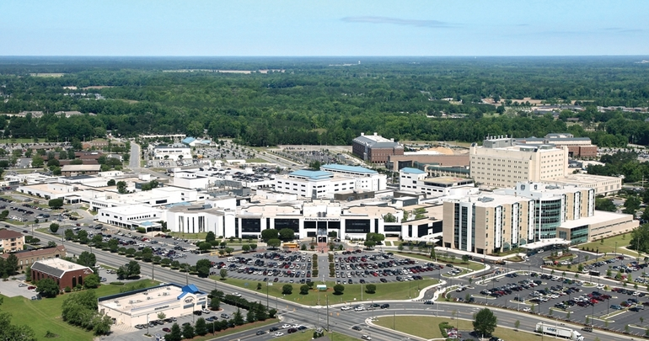
Pitt County Memorial Hospital SIU & PACU-3yrs
Notes:
Located in Greenville, NC. At the time was 650 bed hospital.

Slide 4
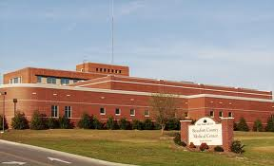
Beaufort County Medical Center PACU-8 years
Notes:
In Washington, NC. 1.5 miles from my house. 94 bed hospital. Born here!

Slide 5
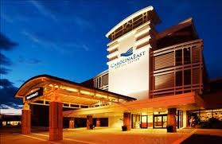
CarolinaEast Medical Center CICU-1 yr

Slide 6
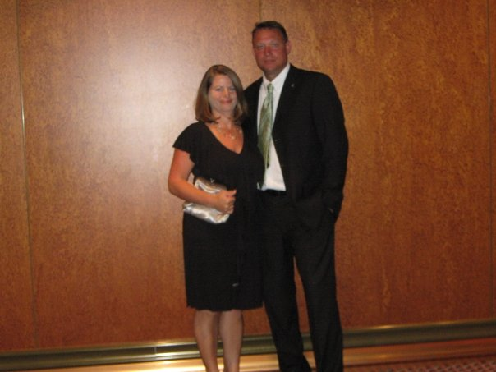
My Family
Notes:
These pics are from a cruise. Bottom right: Roatan Honduras-Capuccin Monkey

Slide 7
Future Plans: St John

Slide 8
Why this topic?
More and more patients are presenting with previous exposure to Heparin and cases of Heparin Induced Thrombocytopenia (HIT).
There is no consensus on how to treat patients with a history of HIT who present for vascular or cardiovascular surgery requiring anticoagulant therapy.

Slide 9
Objectives:
Participants will gain basic knowledge of Heparin Induced Thrombocytopenia (HIT) and be able to discuss which patients are at most risk for developing it.
Participants will gain a working knowledge of the pharmacology of Argatroban including its mechanism of action, dosing in normal adult patients as well as some special populations, indications, and metabolism and excretion.
Participants will gain knowledge of information existing in the current literature regarding Argatroban use in vascular and cardiovascular surgery.

Slide 10
What is HIT?
A rare but lethal syndrome-antibodies form against complexes of platelet factor IV and heparin.
Profound thrombocytopenia sometimes associated with thrombosis (venous>arterial).
Venous thrombosis-DVT, PE
Arterial thrombosis-MI, ischemic limb damage often requiring amputation.
Mortality rate can reach 20-30%

Slide 11
Who is at highest risk for HIT?
Heparin use >4days
Unfractionated>low molecular weight
Bovine>Porcine
Surgical, Cardiac, and Orthopedic use>Medical use.

Slide 12
Anticoagulation Options for Vascular/Cardiovascular Sx after HIT
Retest for HIT antibodies. Antibodies usually undetectable within 50-80 days. If negative, some studies suggest that a brief Heparin re-exposure is considered safe.
It takes at least 5 days for HIT antibodies to regenerate if they regenerate at all (Warkentin, 2004).
If positive for HIT antibodies, an alternative anticoagulant should be used.
Notes:
Testing for HIT Antibodies: ELISA (enzyme-linked immunosorbent assay)-many false positives-can be done on site.
Those with a positive ELISA are tested further with a serotonin release assay (SRA)-usually sent out to a regional lab.

Slide 13
Alternate Anticoagulants
Recombinant Hirudin (Lepirudin, Desirudin)-thrombin inhibitor resembling the potent thrombin inhibitor in medicinal leeches. Requires ecarin clotting time to monitor.
Bivalirudin (Angiomax)-thrombin inhibitor.
Danaparoid-a “heparinoid” with predominant anti-factor Xa rather than anti-thrombin activity. *No longer on the market in the U.S.
Notes:
The Recombinant Hirudins and Bilalirudin require renal dosing.

Slide 14
Argatroban: Mechanism of Action
Synthetic direct thrombin inhibitor. Binds reversibly to the thrombin active site. Does not require co-factor antithrombin III for antithrombotic activity.
Inhibits thrombin-induced rxns (fibrin formation, activation of factors V, VIII, XIII, activation of protein C, and plt aggregation)
No interaction with Heparin induced antibodies.
No reversal agent.

Slide 15
Argatroban: Metabolism and Excretion
Metabolized by hydroxylation and aromatization in the liver.
4 metabolites-only one (M1) is active and exerts a 3-5 fold weaker anticoagulant effect.
Terminal elimination half life 39-51 minutes.
Excreted primarily in the feces presumably through biliary secretion.

Slide 16
Argatroban: Indications
FDA approved as: (1) an anticoagulant for prophylaxis or treatment of thrombosis in pts with HIT. (2) an anticoagulant in pts with/at risk for HIT undergoing percutaneous coronary intervention (PCI)
The safety and effectiveness for cardiac indications outside PCI in pts with HIT has not been established.

Slide 17
Argatroban: Preparation
Comes in 250mg (2.5ml) vials and must be diluted in 250ml of NS, Sterile water, or LR to a 1mg/ml concentration.

Slide 18
Argatroban: Dosing (for PCI)
Bolus 350mcg/kg over 3-5 min, then gtt at 25 mcg/kg/min. Check ACT 5-10 min after bolus.
If <300 sec, bolus with 150mcg/kg and increase gtt to 30 mcg/kg/min. Recheck ACT in 5-10 min.
If >450 sec, decrease gtt to 15 mcg/kg/min and recheck ACT in 5-10 min.
Goal: ACT 300-450 sec. Once achieved, keep gtt at the current rate throughout the procedure.

Slide 19
Dosing for Cardiovascular Surgery?
Per the policy at CarolinaEast, the dosing is the same as for PCI with the exception of: if the ACT is >500 sec (instead of 450 sec) decrease the infusion dose to 15 mcg/kg/min.
ACT should be obtained every 15-20 min to verify appropriate anticoagulation.
Therapeutic ACT for CV sx?

Slide 20
Dosing for Vascular Surgery?
Off-label use.
In a recent carotid endarterectomy at CEMC, in a pt with a hx of HIT, we gave 50 mg over 5 min then started an infusion of 2 mcg/kg/min. No ACT was checked. The infusion was stopped just prior to removal of the cross-clamp. No adverse effects.
In a similar case for a CEA, (2005), a 150 mcg/kg bolus was used followed by a 5mcg/kg/min infusion. ACTs were obtained every 15 min and the dose titrated to keep the ACT ~200 sec. No adverse effects.
In a case study, (2003), for a axillobifemoral bypass, an infusion of 2.7 mcg/kg/min was started 30 min prior to arterial clamp to achieve an ACT of 150 sec. No adverse effects.
Notes:
No institution specific policy at CEMC for vascular surgery.

Slide 21
Dosing for Vascular Surgery?
In a study by Ohteki et al in 2000,16 pts received Argatroban during peripheral vascular surgery:
4 pts: 50 mcg/kg bolus. ACT ↑ from 88 sec (baseline) to 132 sec and returned to 96 sec in 30 min
4 pts: 100 mcg/kg bolus. ACT ↑from 88 sec (baseline) to 150 sec and returned to 98 sec in 30 min
8 pts: 100mcg/kg bolus then 2 mcg/kg/min infusion. Intraop mean ACT150 sec. * Suggested for pts requiring clamp time >30 min.
Notes:
Boluses were given prior to arterial clamping.

Slide 22
Dosing in special populations
No special dosing required for pts with renal impairment.
Dosing for pts with hepatic impairment should be decreased. Initial dose should be decreased to ¼ based on the approximate 4 fold decrease in clearance relative to those with normal hepatic function (2009).

Slide 23
Pharmacokinetics
When administered by infusion, anticoagulant effects and plasma concentrations follow similar, predictable response profiles with low intersubject variability.
Anticoagulation effects begin immediately upon initiation of infusion as Argatroban levels rise.
For infusion rates up to 40mcg/kg/min, Argatroban increases the aPTT, ACT, PT, INR, and TT in a dose-dependent fashion.

Slide 24
What does the research show?

Slide 25
Argatroban as a substitute of heparin during cardiopulmonary bypass: a safe alternative? (Follis et al 2010)
A case report: Argatroban used for Mitral Valve Replacement during CPB in a pt with HIT.
Clotting of the oxygenator required prompt replacement after release of the cross-clamp (ACT was 495 at the time).
Upon termination of Argatroban, the ACT remained elevated beyond the expected half-life.
Suggested restricting its use to cases in which other anticoagulants are contraindicated (renal failure or ecarin clotting time not available).
Notes:
This is the article I emailed to everyone.

Slide 26
Argatroban as a substitute of heparin during cardiopulmonary bypass: a safe alternative? (Follis et al,2010)
Lit review: 13 cases (4 infants)reviewed in which Argatroban used instead of Heparin during CPB for cardiac surgery.
3 observations based on lit review: 1) longer time than expected for coagulation assays to normalize after infusion stopped. 2) Significant postop bleeding (measured by amount of blood products given). 3) clots in reservoir/oxygenator of CPB in 2 cases.
Notes:
This is the article I sent out to everyone.

Slide 27
Possible explanation for prolonged normalization of ACTs
Addition of the corporeal circuit and reservoir increases the volume of distribution of the drug. Suspension of Argatroban coincides with discontinuation of CPB and reinfusion of the Argatroban rich remaining blood in the oxygenator which may act as a new bolus dose.
A transient impairment of liver function post-CPB

Slide 28
Possible explanation for clots in oxygenators (3 total cases)
Prolonged CPB time in each case increasing the likelihood that over time the distribution of the drug does not remain constant in the reservoir of the oxygenator.
Concurrent antifibrinolytic usage may have acted as a procoagulant.
The incident occurred when the infusion of Argatroban was being decreased to maintain ACT ~500. The levels may have dropped more in the reservoir than they did in the pt.

Slide 29
Conclusion
Argatroban use in Cardiovascular/Vascular surgery should be restricted to pts with HIT who have renal failure causing contraindication of Hirudin.

Slide 30
Recommendations when Argatroban used
Consider withholding antifibrinolytic agents
Once ACT 500-600 has been achieved, the infusion should be maintained at a constant rate until completion of CPB when the infusion can be stopped.
Use a low volume prime oxygenator and dispose of blood remaining in the reservoir (Argatroban rich) upon termination of CPB.
Select minimally invasive surgery approaches when possible to decrease the level of anticoagulant required and need for CPB.

Slide 31
Questions? Comments?
How many of you have used Argatroban?
What was your experience?
Remember: NO Heparin in pressure bags and NO Heparin coated PA catheters in pts with HIT!

Slide 32
References
Follis, F., Filippone, G., Montalbano, G., Floriano, M., LoBianco, E., D’Ancona, G., & Follis, M. (2010). Argatroban as a substitute of heparin during cardiopulmonary bypass: a safe alternative? Interactive Cardiovascular and Thoracic Surgery , 10, 592-596.
GlaxoSmithKline website. (2009). http://www.gsksource.com/gskprm/en/US/partnerMkt/gskprm?cmd=Pri...
Hallman, S. E., Hebbar, L., Robinson, J., & Uber, W. E. (2005). The use of Argatroban for carotid endarterctomy in heparin-induced thrombocytopenia. Anesthesia & Analgesia, 100, 946-948.

Slide 33
References
Ohteki, H., Furukawa, K., Ohnishi, H., Narita, Y., Sakai, M., Doi, K. (2000). Clinical experience of argatroban for anticoagulation during cardiovascular surgery. Jpn J Thoracic Cardiovasc Surg, 48, 39-46.
Tokuda, Y., Matsumoto, M., Sugita, T., Nishizawa, J., Matsuyama, K., Yoshida, K., & Matsuo, T. (2003). Vascular surgery using argatroban in a patient with a history of heparin-induced thrombocytopenia. Circulation Journal, 67, 889-890.
Warkentin, T. E. (2004). Heparin-induced thrombocytopenia and vascular surgery. Acta chir belg, 104, 257-265.

